Slide 1
A Community Group working with the Parish Council to make our town even better.

Slide 2
Bishop’s Waltham’s Greening Campaign
Our first major project during 2024 -25 is

Slide 3
The Five Greening Pillars
Space for Nature
Energy Efficient Warmer Homes
Cycle of the Seed
Waste Prevention
Health Impacts of Climate Change

Slide 4
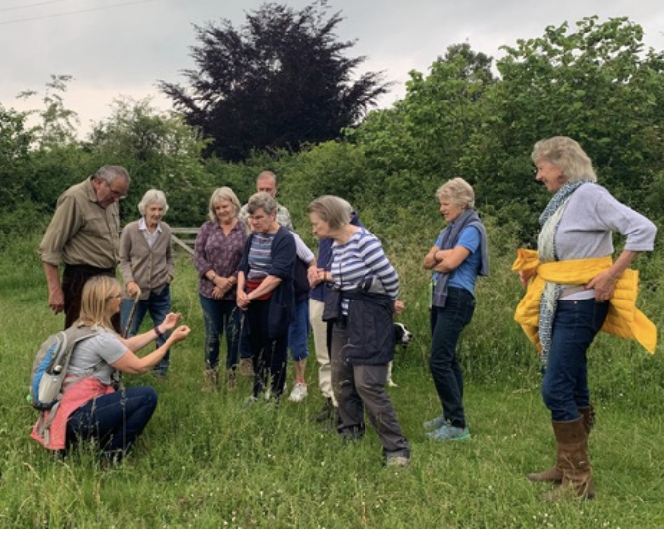
Space for nature
Helping nature - with Hampshire & Isle of Wight Wildlife Trust we can make a real difference for nature in our community.
Increasing biodiversity and capturing carbon through nature.
Mapping and improving our existing habitats, creating new habitats, and linking them together with wildlife corridors.

Slide 5
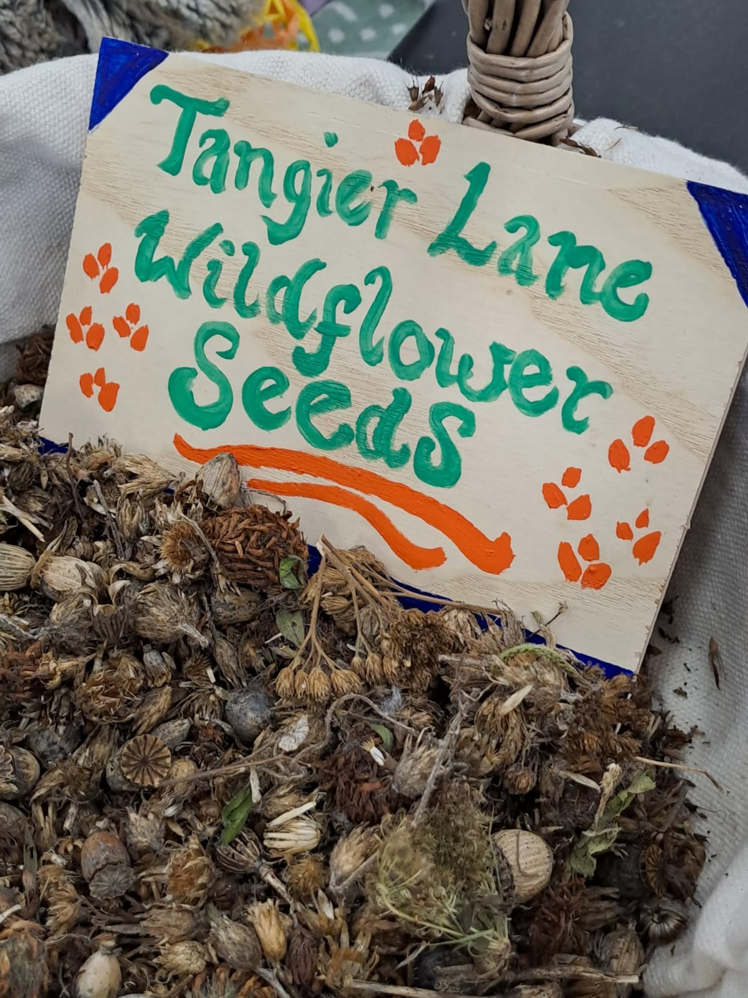
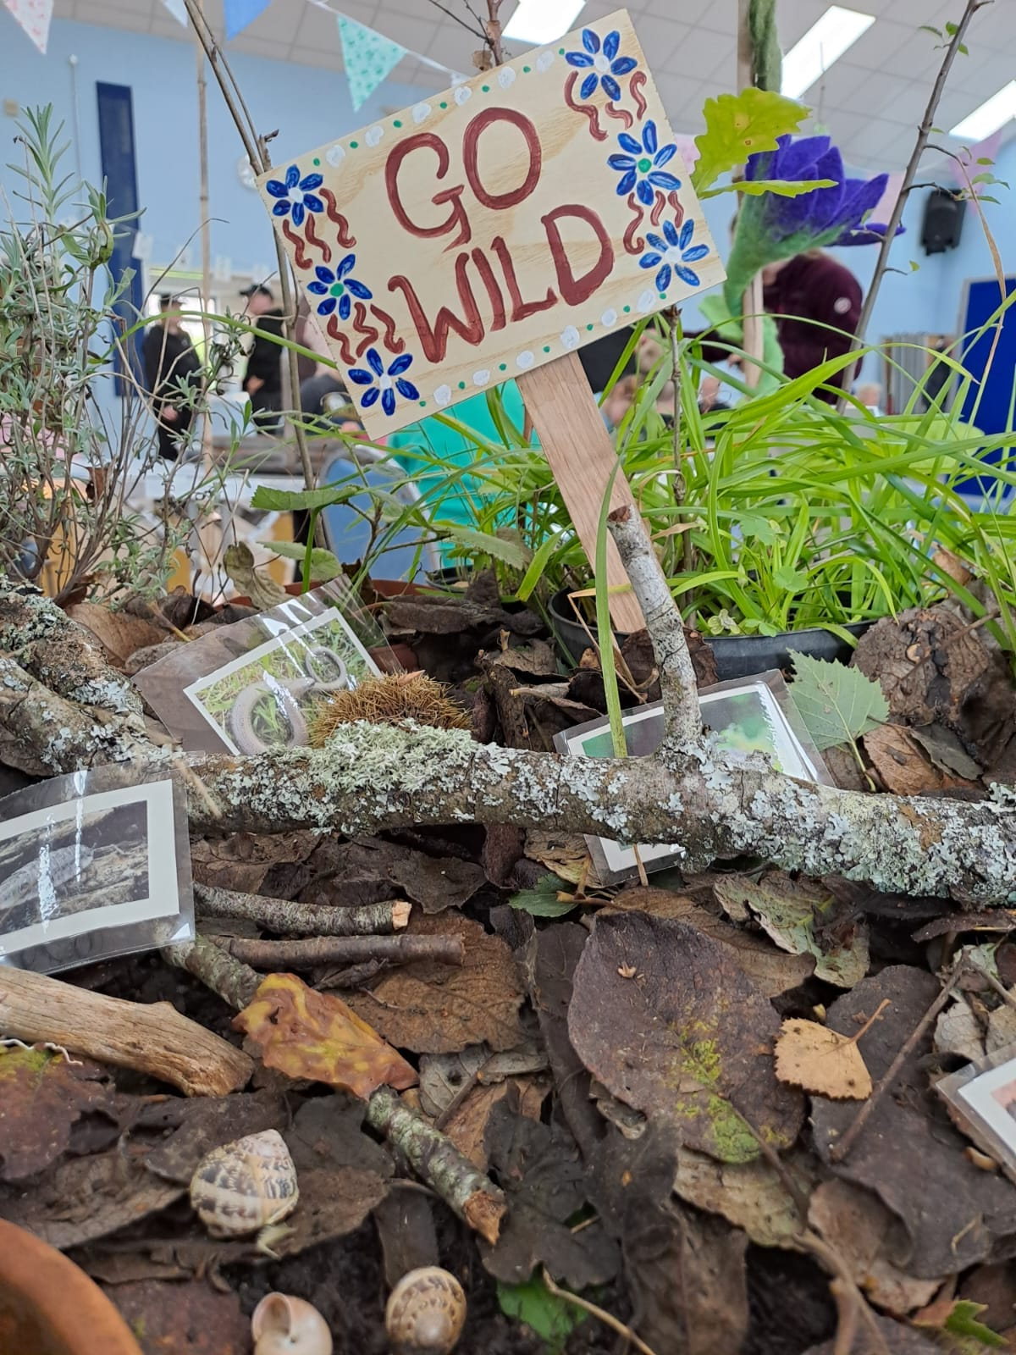
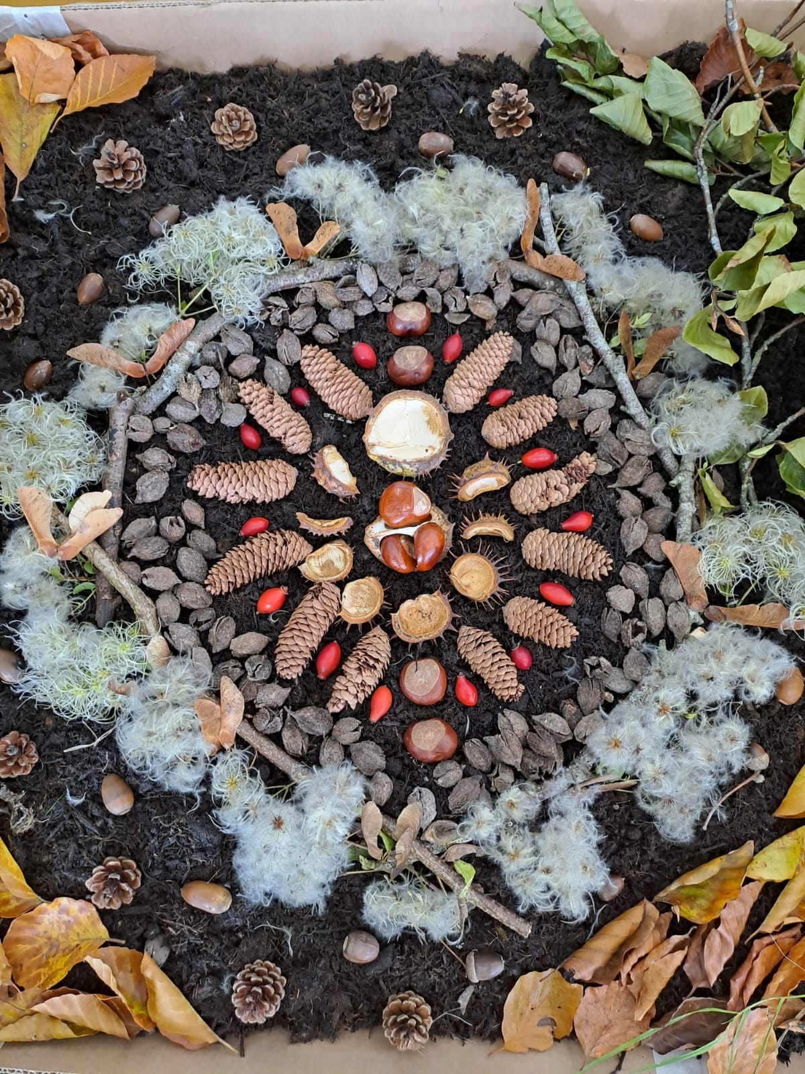
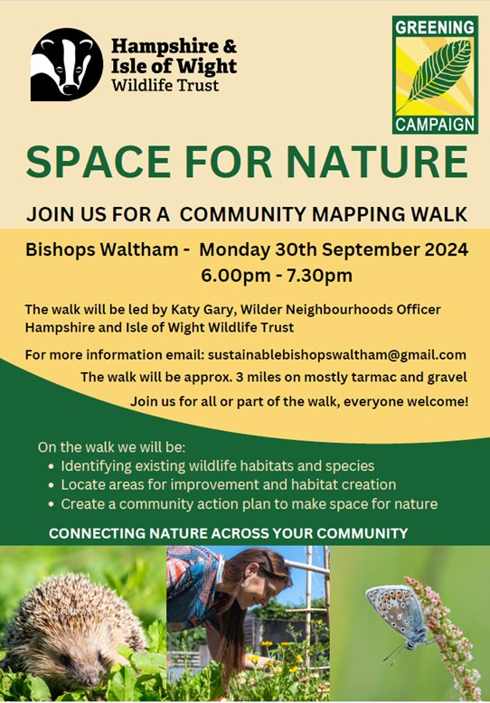
Progress to date:
Mapping of open spaces to identify potential to support more wildlife.
Locally sourced wildflower seeds given away at launch event.

Slide 6
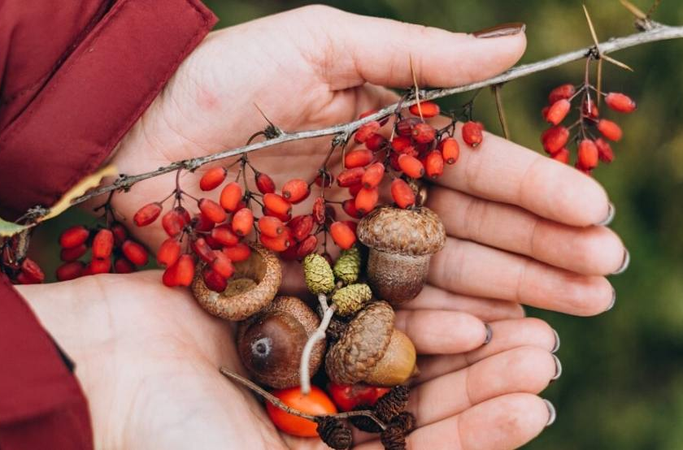
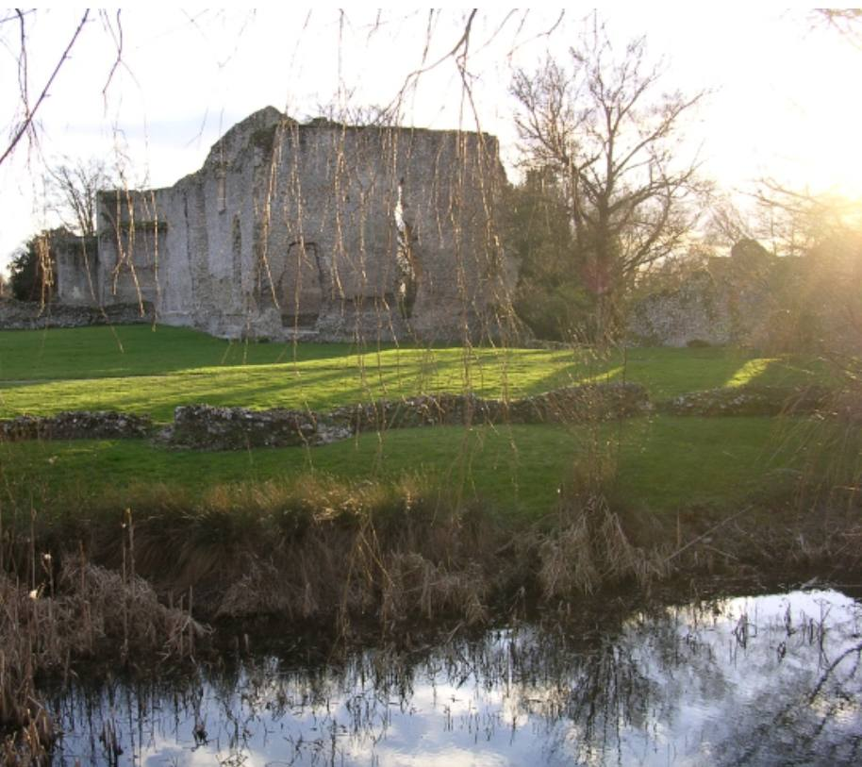
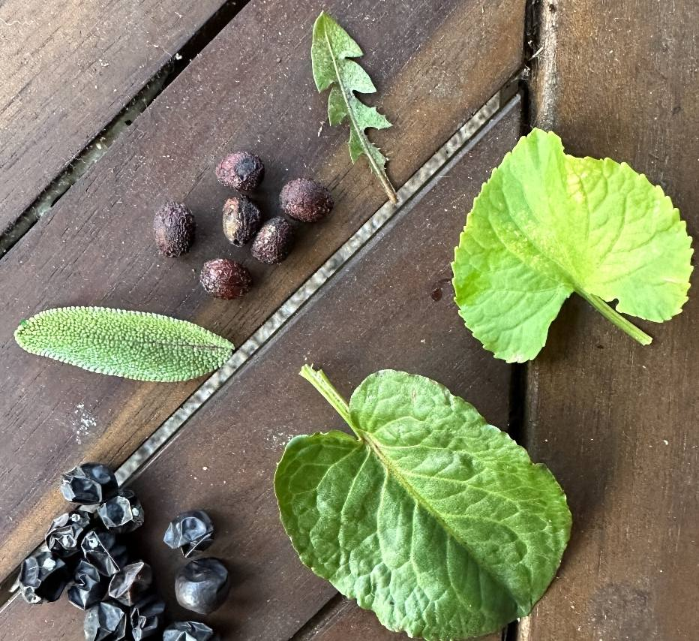
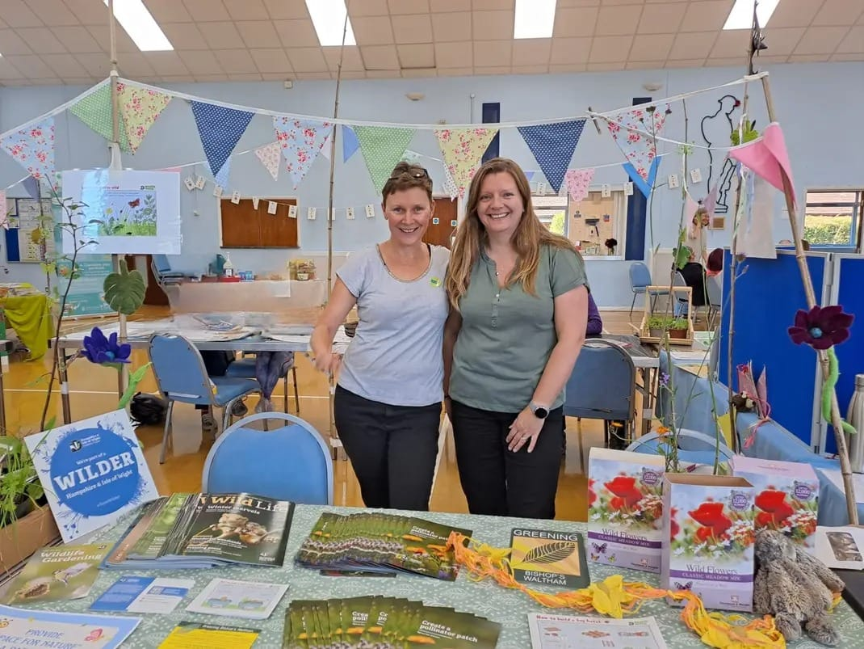
Progress to date:
Over 40 tree saplings given away to residents (Nov `24).
Foraging and Local Folklore Walk held in Bishop’s Waltham (Feb `25).

Slide 7
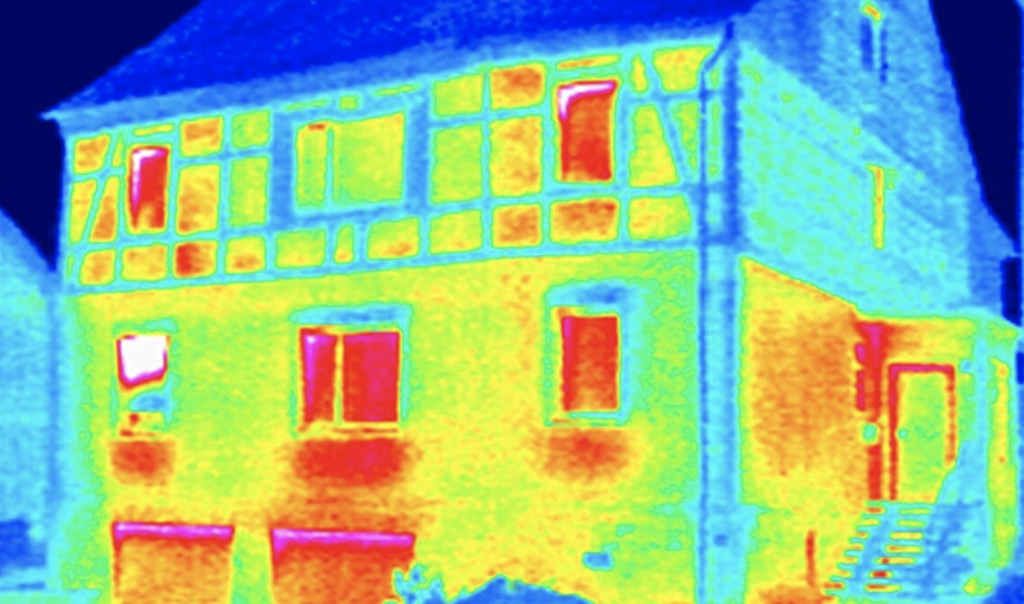
Energy Efficient
Warmer Homes
Reducing our energy usage and CO₂ output to mitigate against climate change.
With the Thermal Imaging Camera you can see where the heat loss and draughts are, which enables you to target energy saving investments.
Advice and information on grants for insulation to reduce energy loss from the Sustainability Centre and the Environment Centre .

Slide 8
Progress to date:
Over 50 homes surveyed with thermal imaging camera (winter 2024-25).
An online “Home Hacks” energy saving advice seminar held.
Radiator Foils and draught excluders given to residents experiencing fuel poverty.
An insulation game and thermal imaging demonstration delivered to two Cub packs, totalling 60 children.

Slide 9
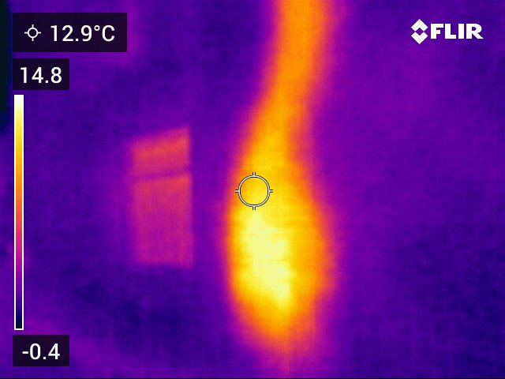
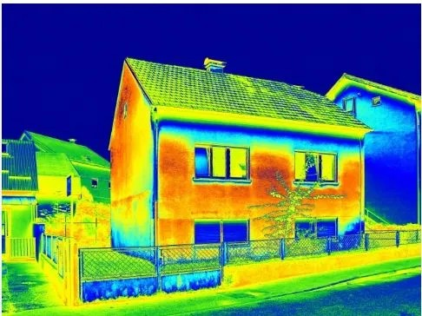
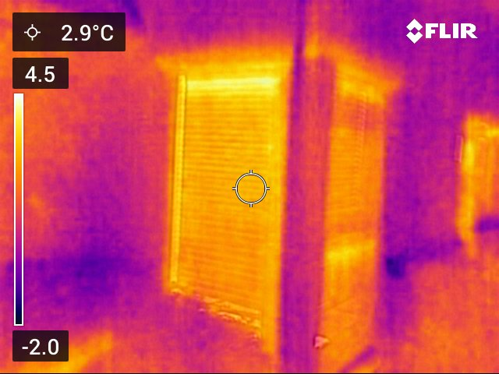
Bishop’s Waltham
Free Loan of Thermal Camera
Would you like to ‘see’ where heat is leaking out of your home?
You can use a thermal camera to help identify the hot spots and draughts.
If you would like to borrow FREE the camera email your details to admin@bishopswaltham-pc.gov.uk
Simple changes save money and CO₂

Slide 10
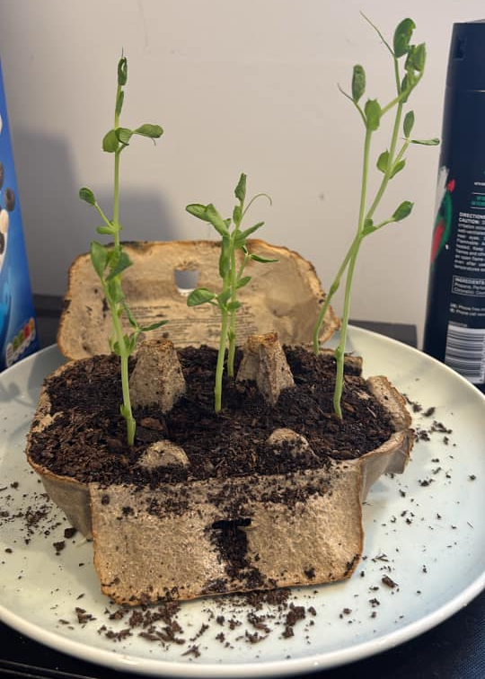
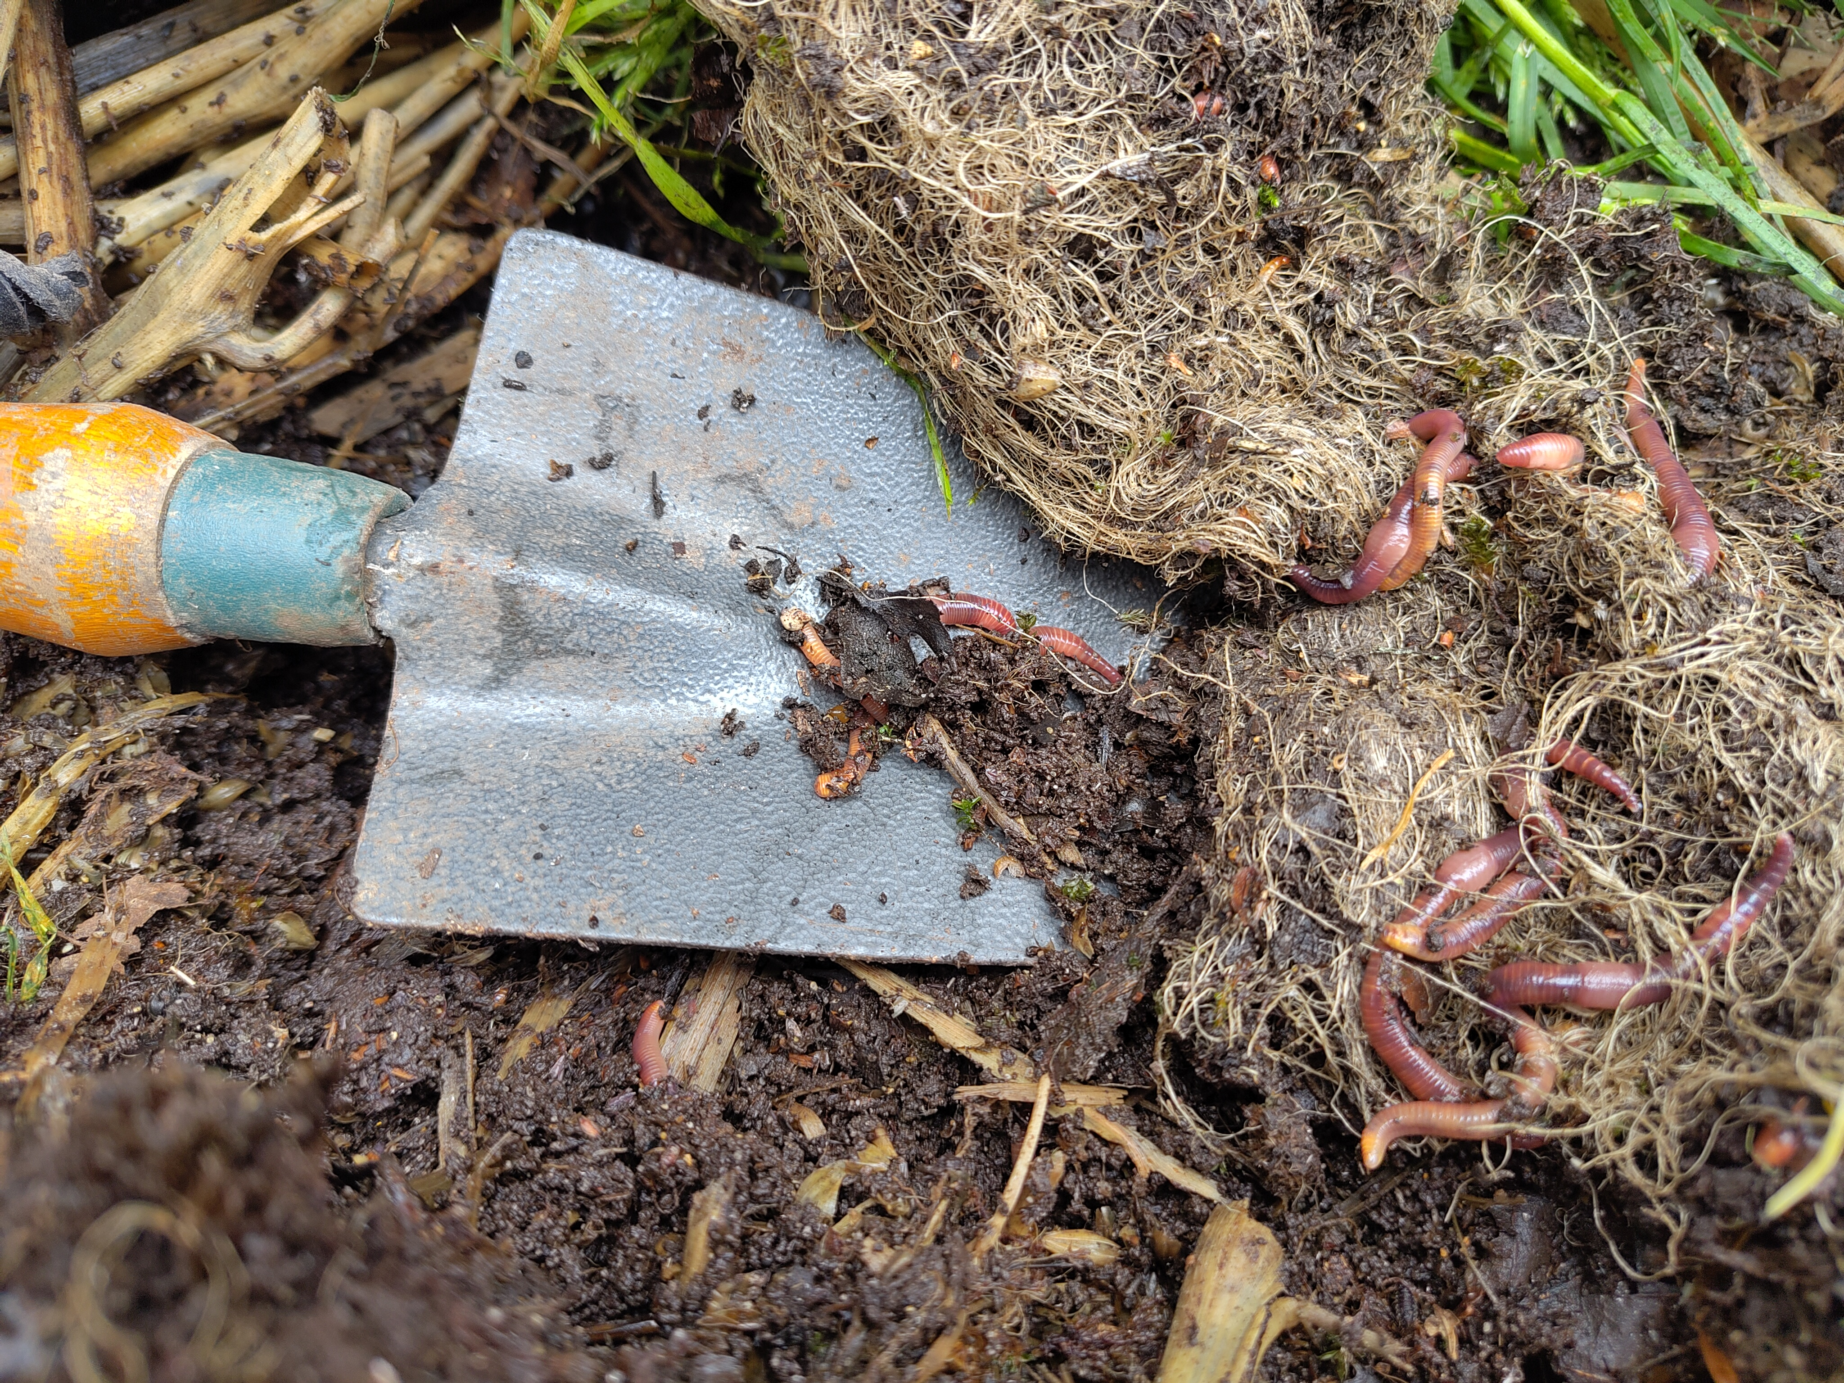
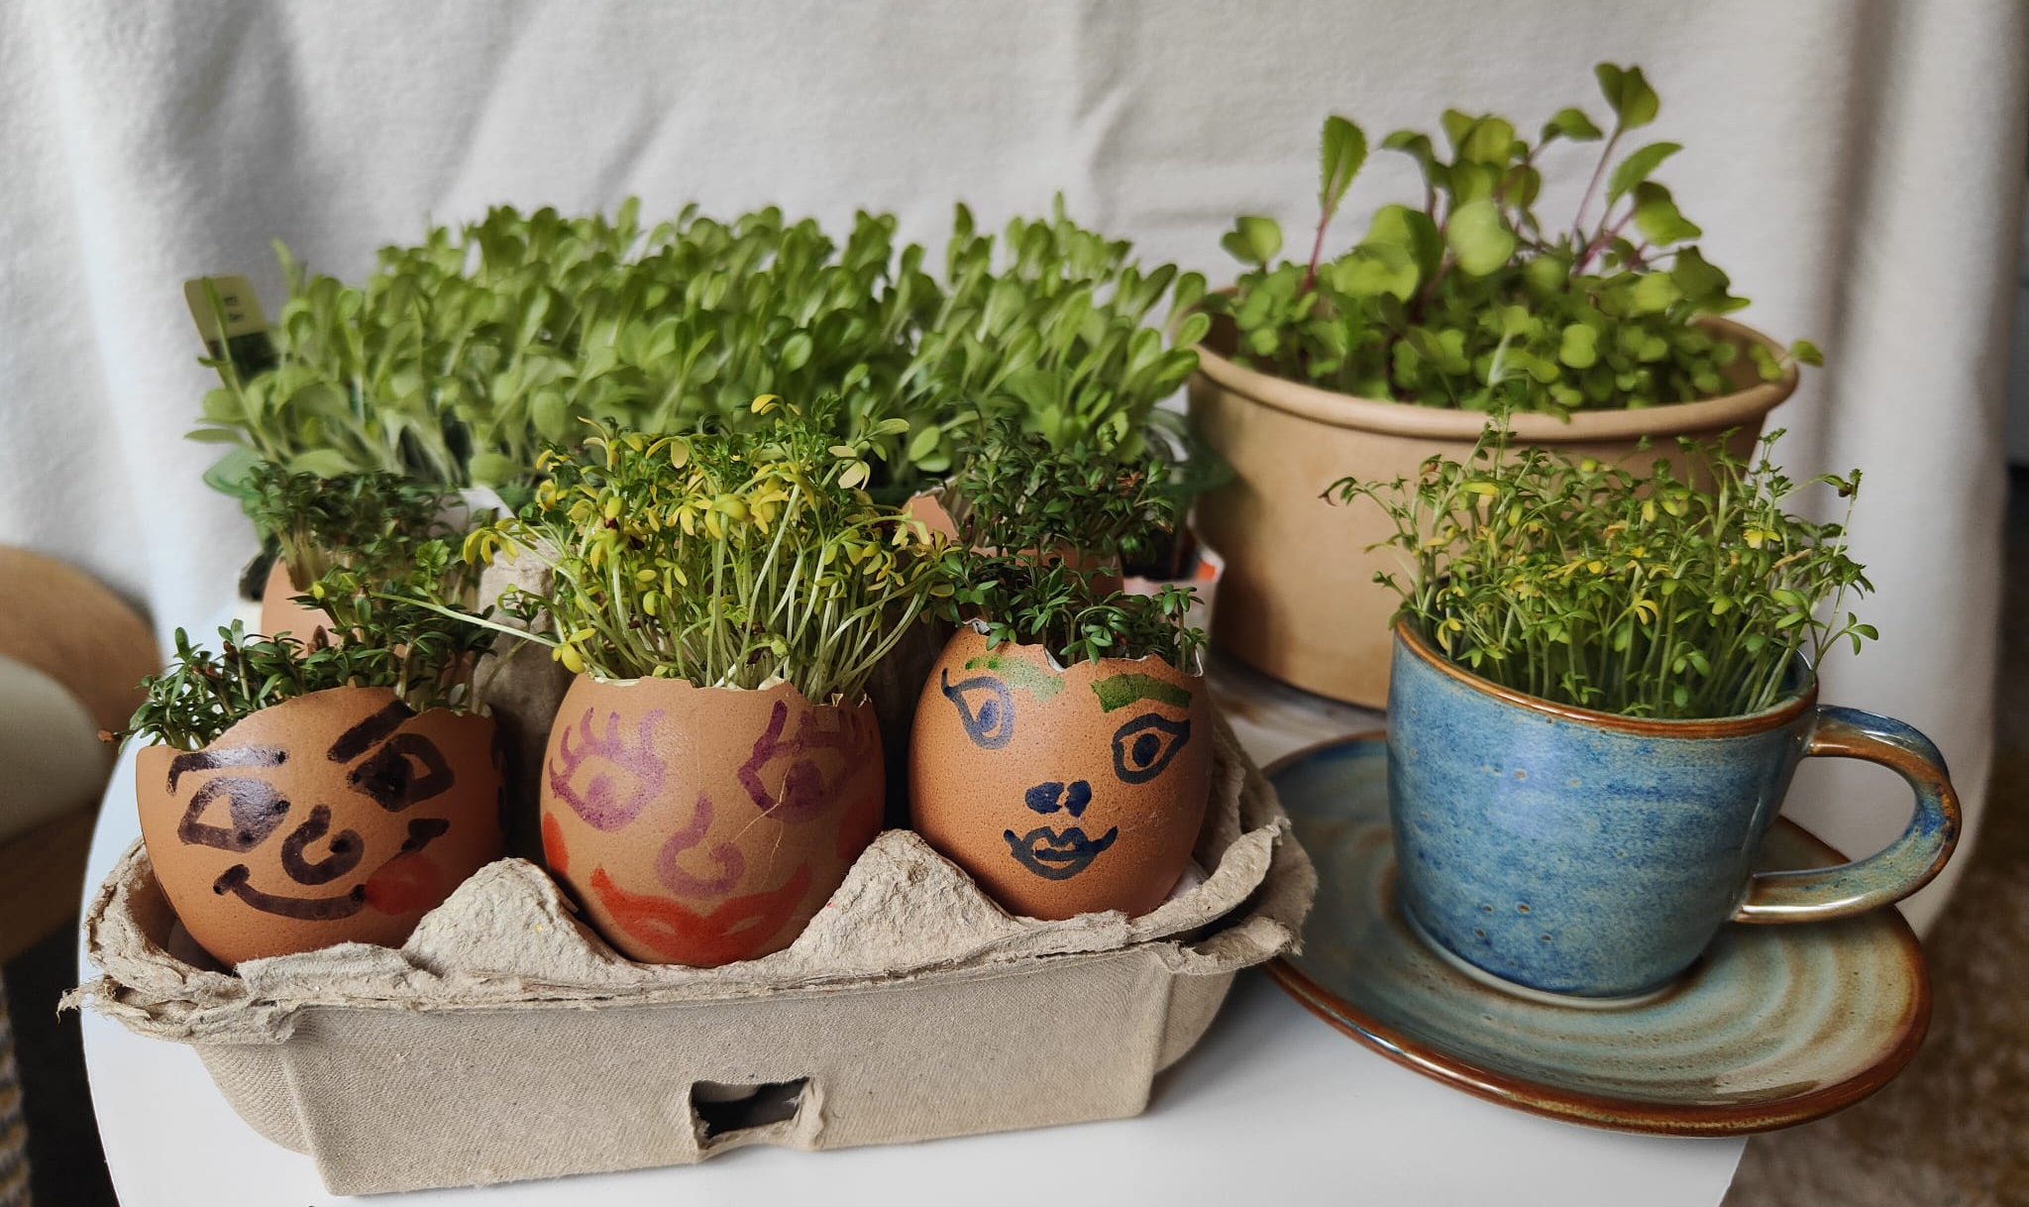
Cycle of the Seed
Food security is a big issue in the UK and we can all get involved to make a difference.
Working with Bishop’s Waltham Junior school we aim to support and encourage everyone to grow food in our community.
Composting and gardening organically improves soil health.

Slide 11
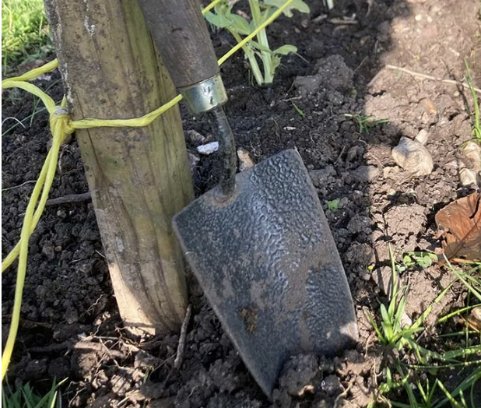
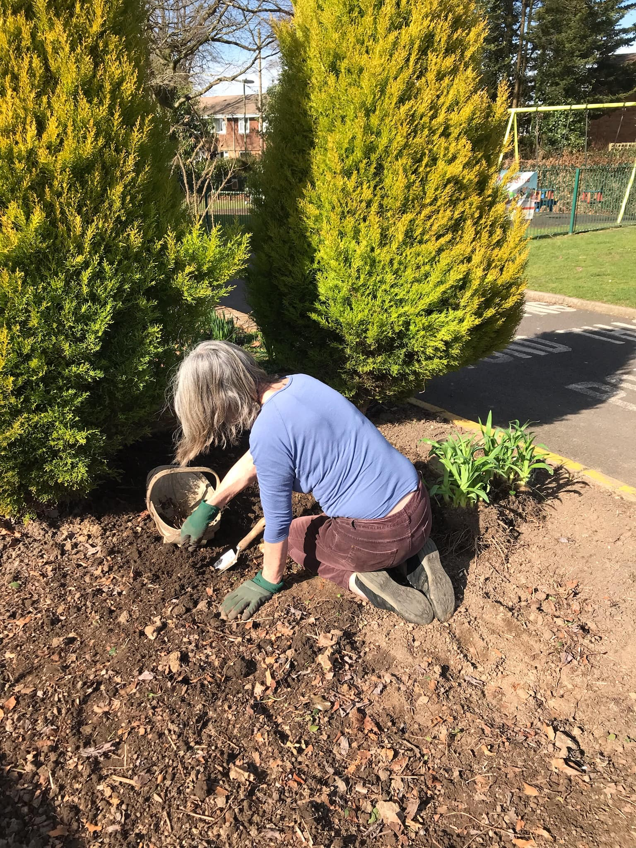
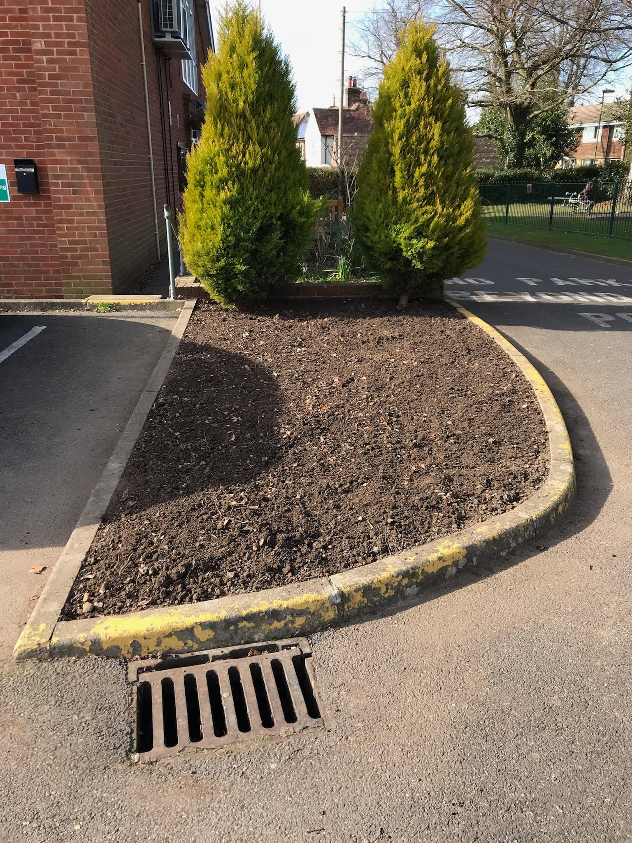
Progress to date:
Preparation of the vegetable bed at the Junior School ready to work with the school’s Gardening Club pupils.
Clearing and planting the bed at Jubilee Hall with herbs and edible plants as a demonstration garden.

Slide 12
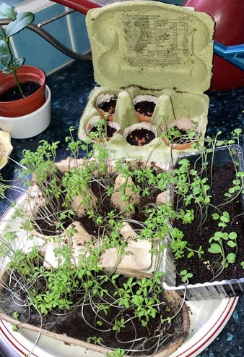
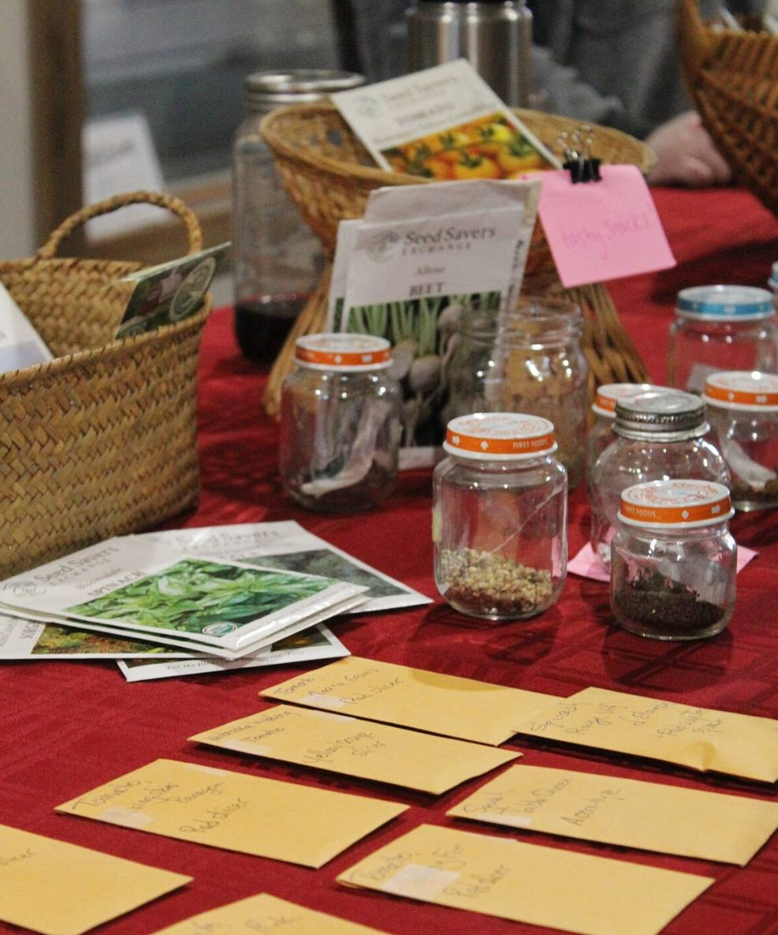
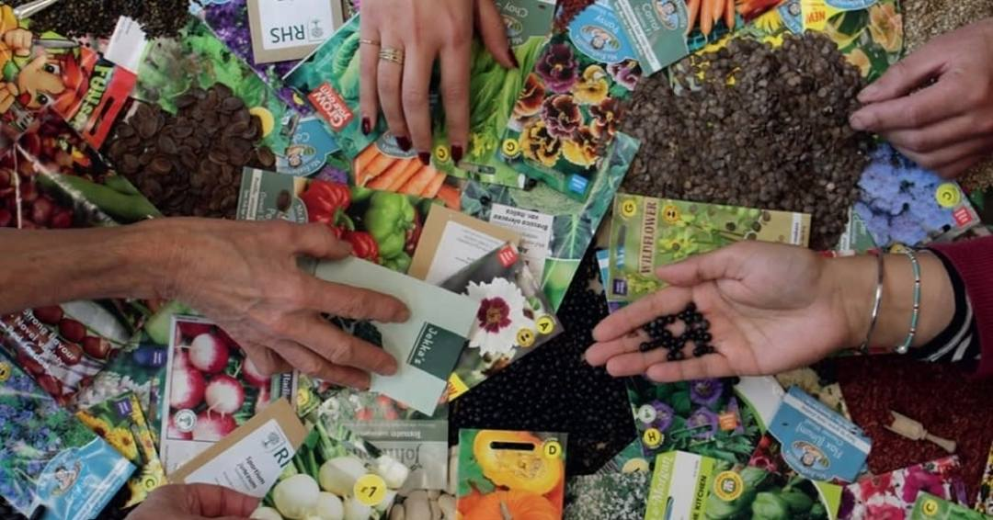
Progress to date:
Gardening in a Box: sowing Peas in egg boxes with two Cub packs, totalling 60 children.
Seed Swap stall at Rethinking Rubbish event (March 2025)

Slide 13
Health Impacts of Climate Change
As the climate changes there are already serious implications for our health and wellbeing.
Keeping ourselves active and well, and our properties undamaged is a priority.
We work with a Health Professional on how to keep our community safe in these changing times.

Slide 14
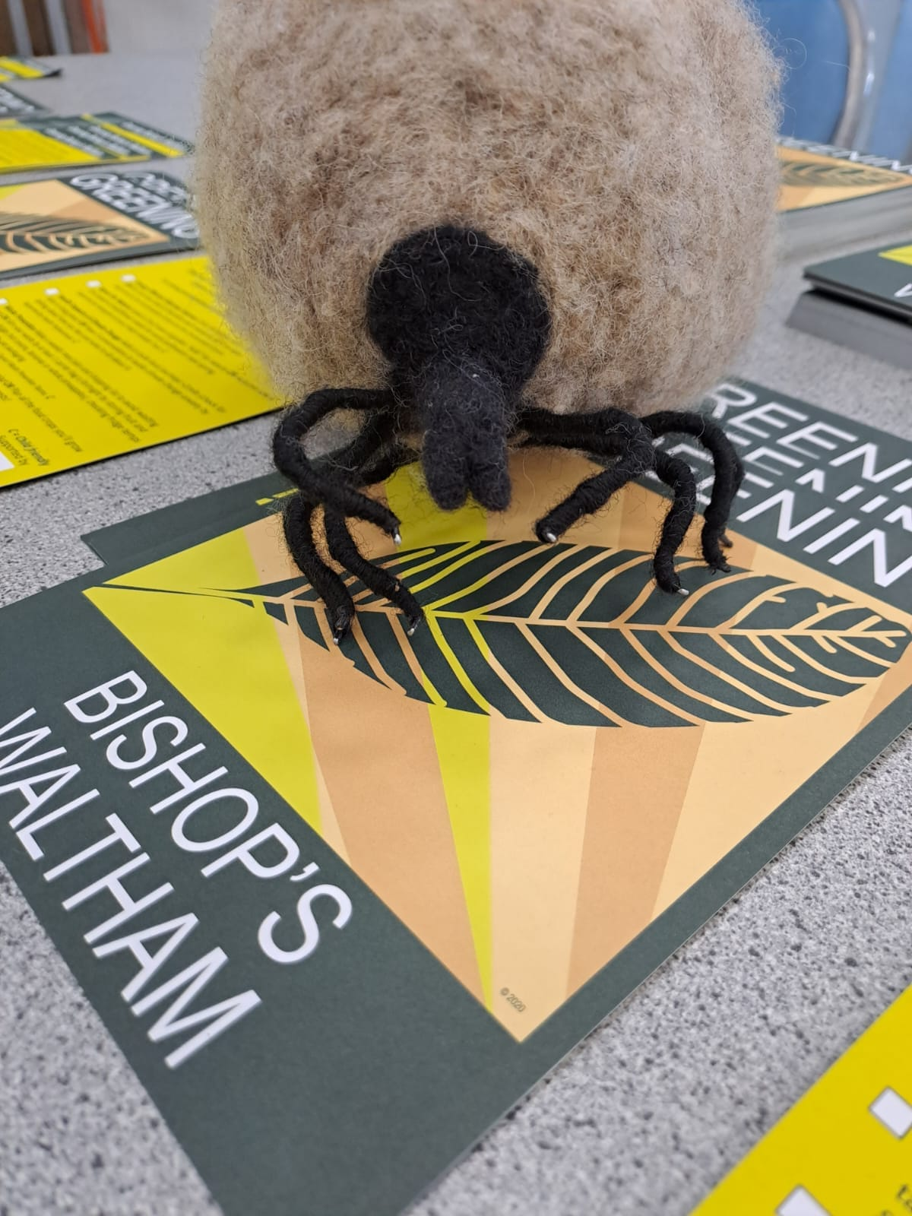
Progress to date:
Engaged with the Junior School to survey interest in a Bike to School pilot project.
Over ten bikes repaired at launch event.
Further Bike Doctors scheduled.
“Terry the Tick” information displayed at launch event.

Slide 15
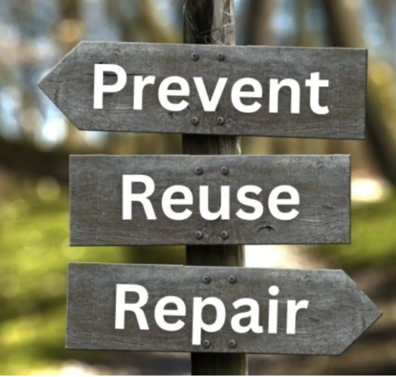
Waste Prevention
Encouraging everyone in our community to prevent waste.
Rather than recycling waste, this pillar focusses on how we actually stop waste occurring in the first place.
The Hampshire County Council Waste Prevention Team are supporting the Greening Campaign by training waste prevention community champions.

Slide 16
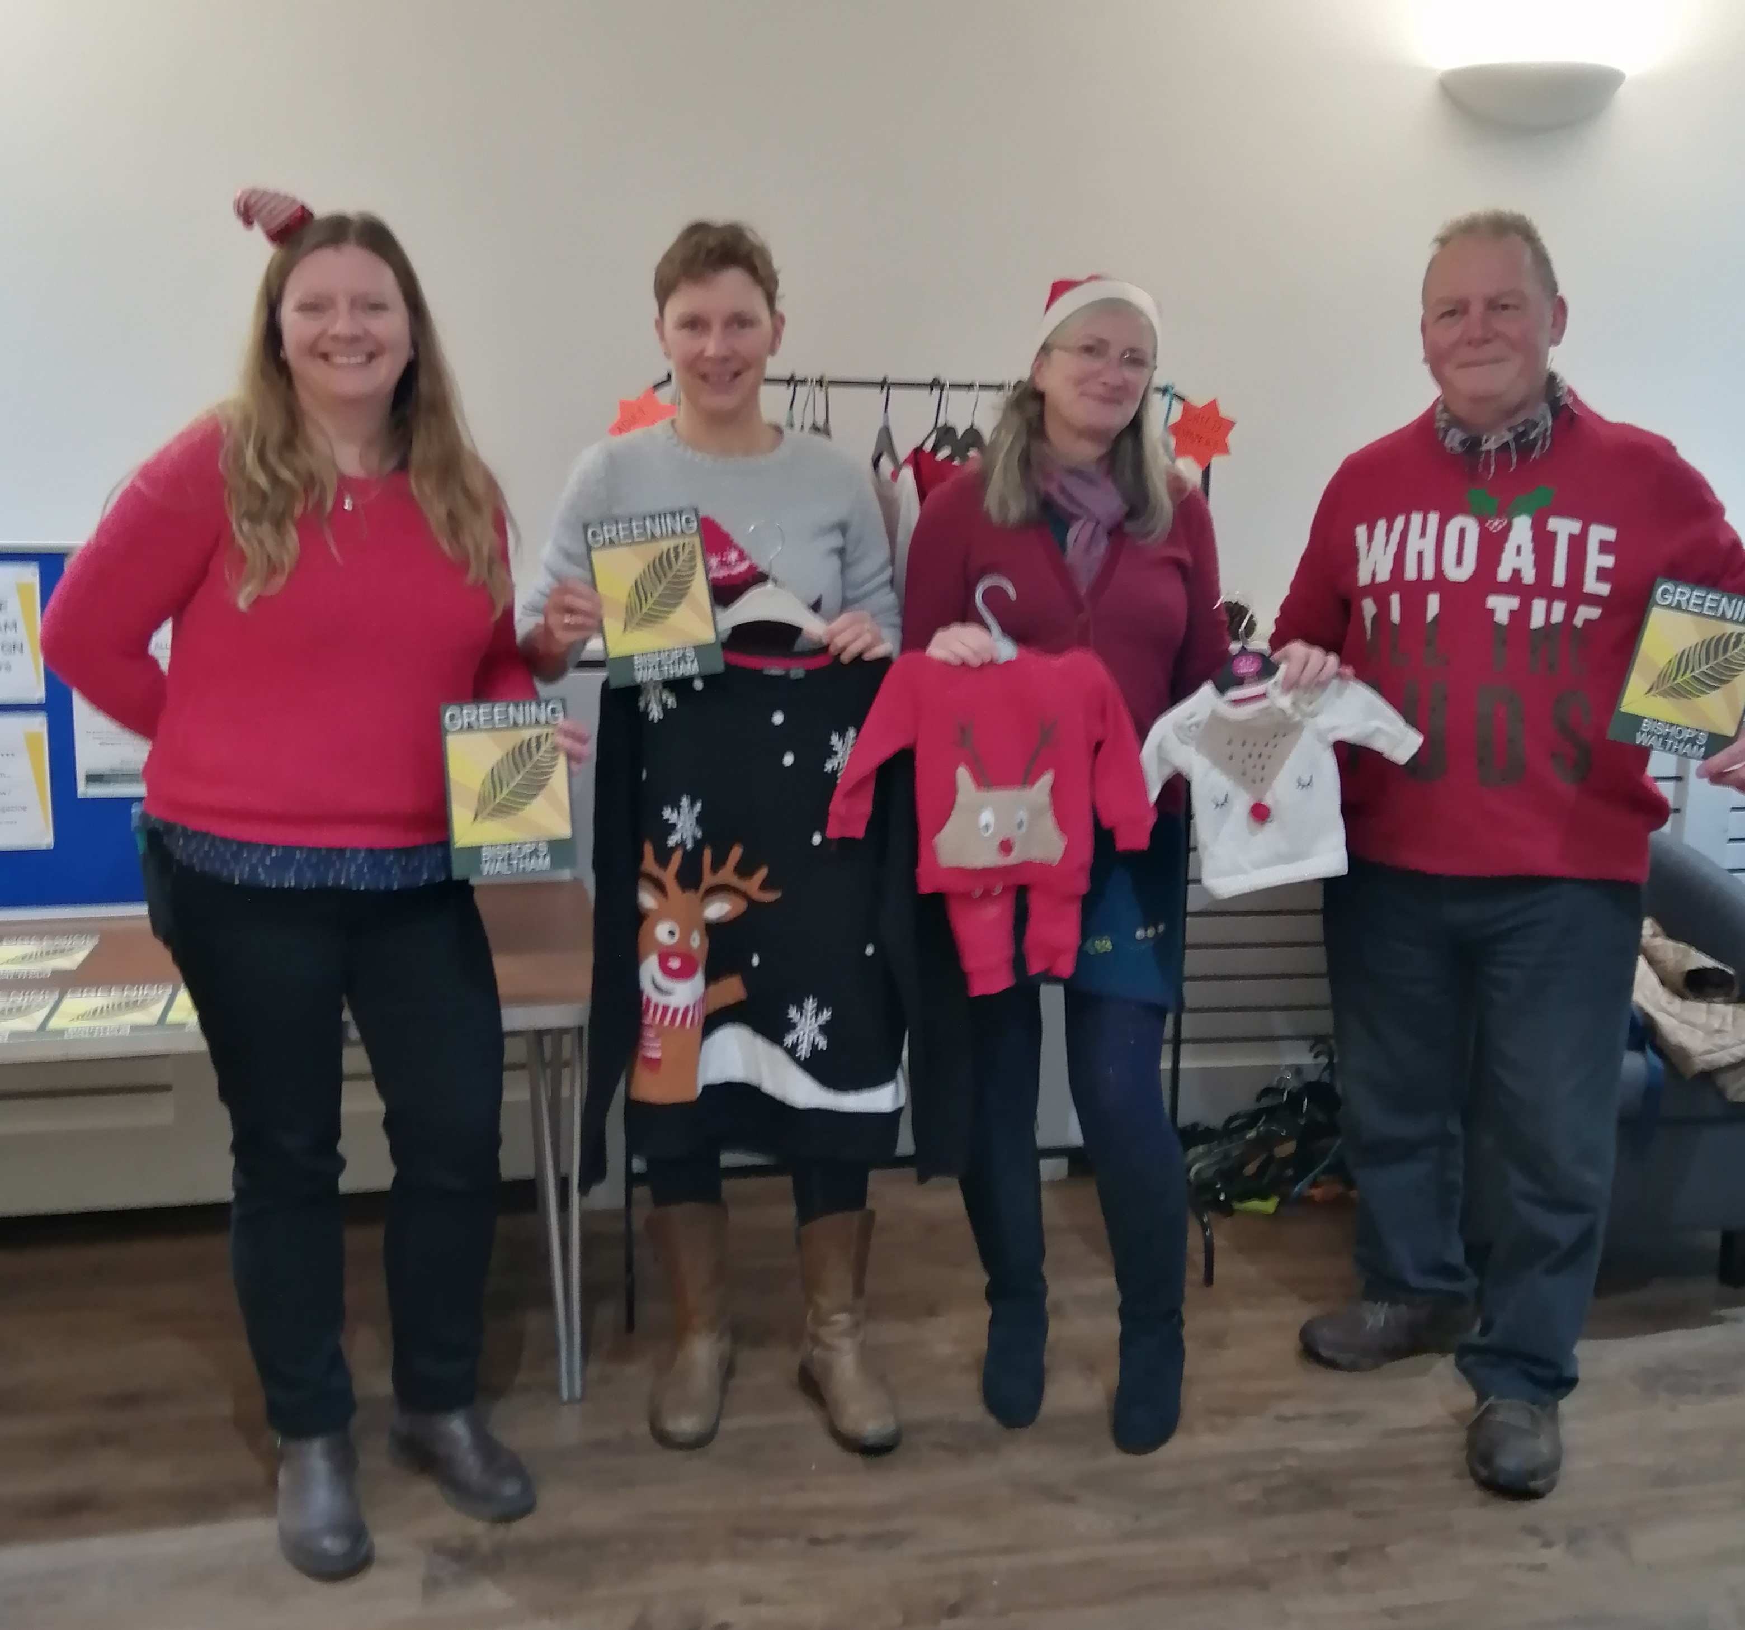
Progress to date:
A trip to Veolia Waste and Energy Recovery plant, Portsmouth
Recycling in Bishop’s Waltham game held with two Cub packs, totalling 60 children (Nov 2024)
Over £120 of products sold at the pop up Zero Waste
Refill shop (Oct 2024).
Over 40 Christmas Jumpers swapped at High Street Christmas Fayre.

Slide 17
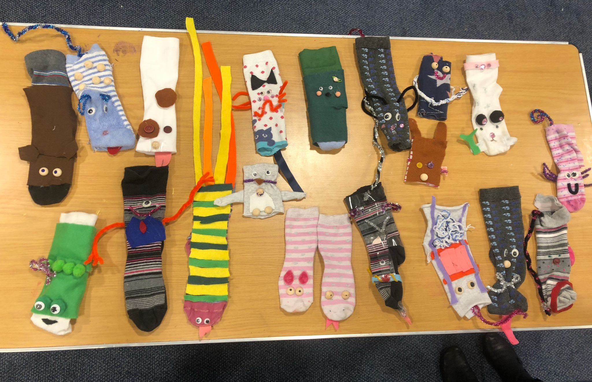
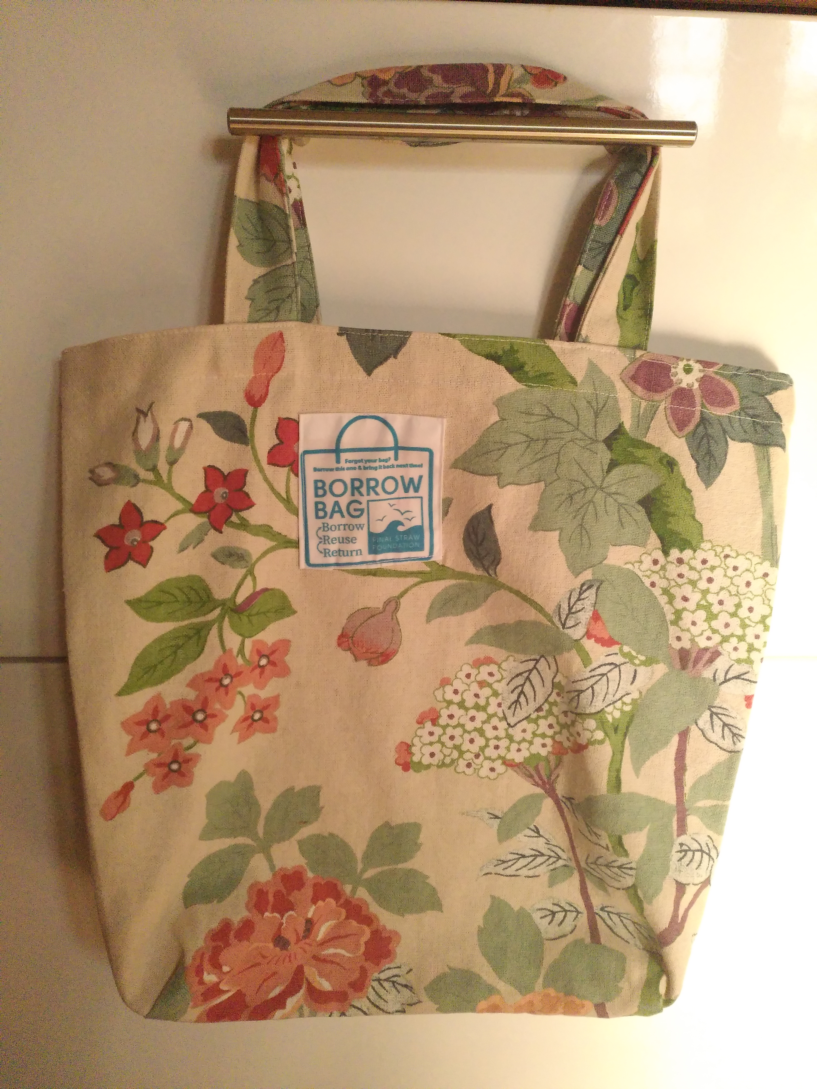
Progress to date:
Borrow Bag scheme launched March `25 with four shops in the High Street and over 120 bags made
Making Sock puppets with 20 Brownies (March `25)
Up-Cycling Tent Material into Pencil Cases workshop with 20 Girl Guides for Sustainable Fashion Badge (March `25)

Slide 19
Sustainable Bishop’s Waltham’s Rethinking Rubbish ! Up-Cycling Competition Launch
A competition to find crafty ways to repurpose what is hard to recycle and difficult to dispose of.
For the most inspiring ideas to either repurpose obsolete equipment into something useful, or a piece of art that will stand the test of time.
Entries to be judged at our Showcase
Event 11th October 2025

Slide 20
2025 Come and find us at:
Annual Parish Meeting, Wednesday 23rd April
Carnival, Saturday 14th June
St Peter’s Country Fayre, Saturday 20th September
Greening Campaign Showcase Event, Saturday 11th October
High Street Christmas Fayre, Thursday 27th November

Slide 21
Bishop’s Waltham’s Greening Campaign
Find out more at:
www.greeningbishopswaltham.uk
Facebook - Greening Bishop’s Waltham

